Slide 1
Big
O
@ Bart B zon

Slide 2


Students pass a package
Students build a house in pairs
O(n)
O(1)
Which takes longer?
And with 7 Billion people?
What scales worst?
Big O?

Slide 3

Students pass a package
Students introduce each other 1 on 1 (after each other)
O(n)
O(n²)
Big O?

Slide 4
How long does something take?
Compiler and programming language
Compiler vs interpreter
https://www.programiz.com/article/difference-compiler-interpreter
Optimisation
https://gcc.gnu.org/onlinedocs/gcc/Optimize-Options.html
Hardware
Pure processing power (e.g. clockspeed)
Parallelization
Multiple cores
Pipelining
FPGA
Algorithm
How does it scale with growing input (Big O)

Slide 5
What is Big O?
Big O, also known as Big O notation, represents an algorithm's worst-case complexity. It uses algebraic terms to describe the complexity of an algorithm.
Big O defines the runtime required to execute an algorithm by identifying how the performance of your algorithm will change as the input size grows. But it does not tell you how fast your algorithm's runtime is.
Big O notation measures the efficiency and performance of your algorithm using time and space complexity. We will focus on time complexity.
https://www.freecodecamp.org/news/big-o-cheat-sheet-time-complexity-chart/

Slide 6
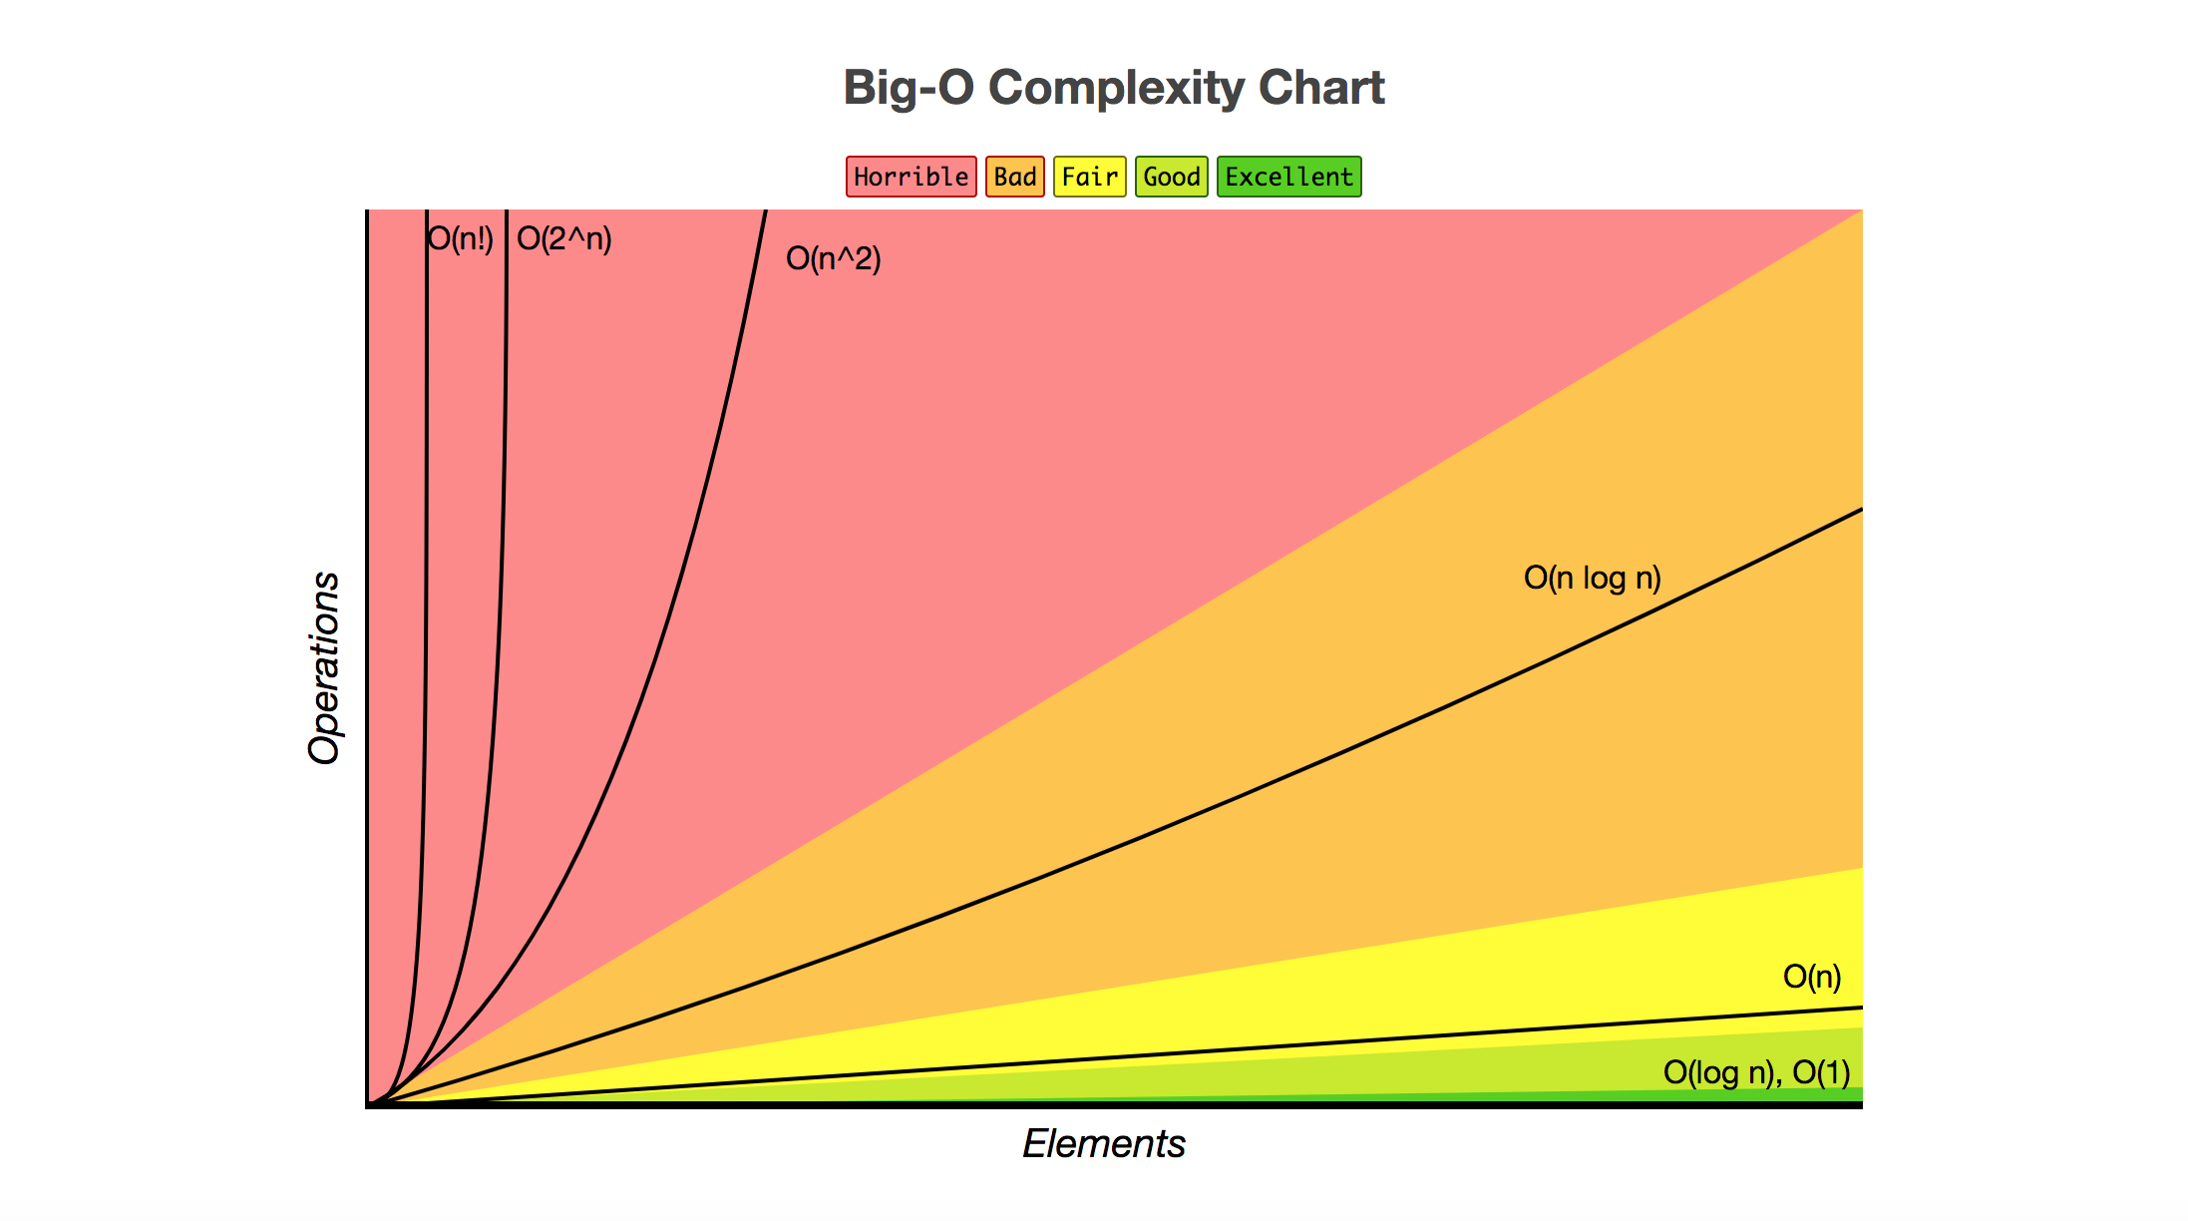
We ignore constant factors
We ignore details related to implementation
We only look at worst case

Slide 7
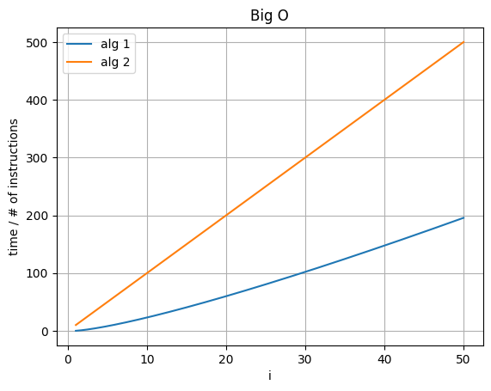
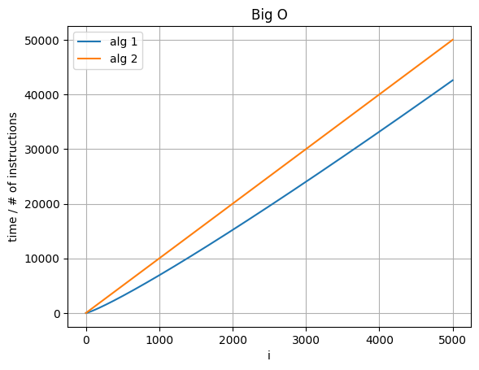
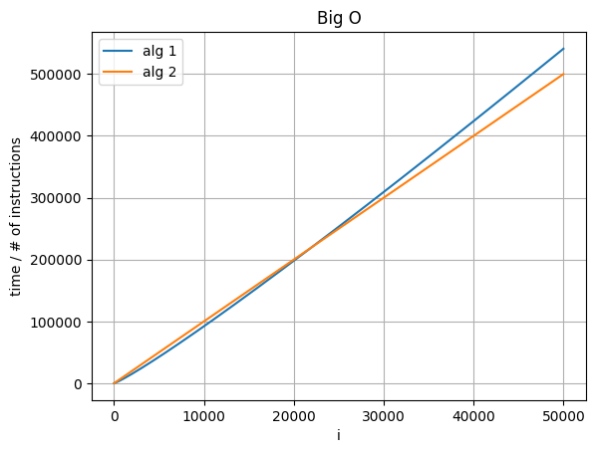
Which is worse?
Which is O(n)?
Which is O(n log n)?

Slide 8
Main Big O types...
Constant : O(1)
Logarithmic : O(log n)
Linear time : O(n)
Linearithmic : O(n log n)
Quadratic : O(n²)
Exponential : O(2^{n})
Factorial : O(n!)

Slide 9
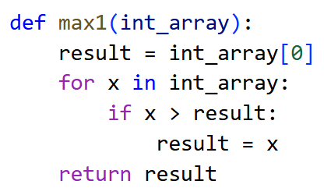
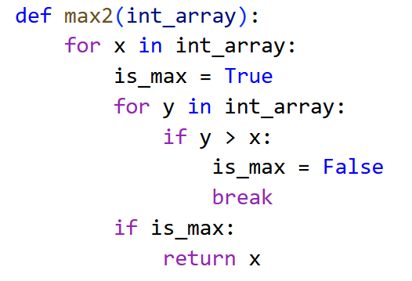
Big O?

Slide 10
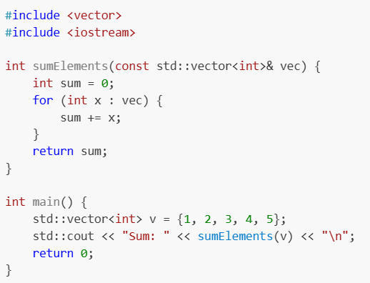
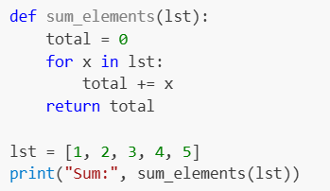
Sum
O(n)
c++
python

Slide 11
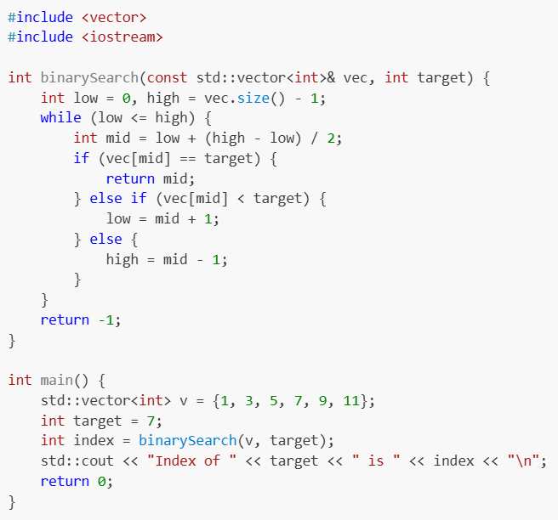
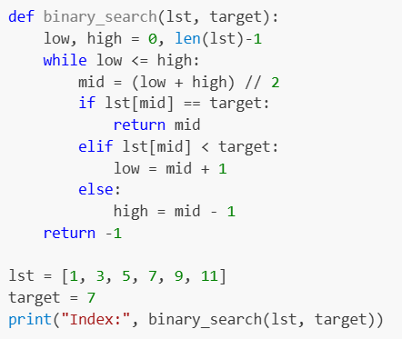
Binary Search
O(log n)
c++
python

Slide 12
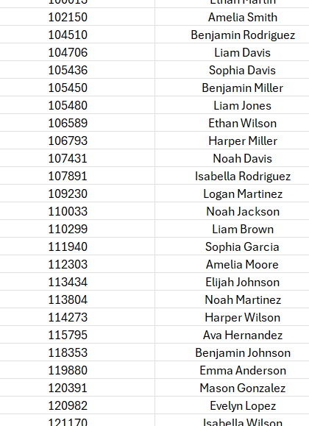
We want to find the name belonging to student number 110299

Slide 13
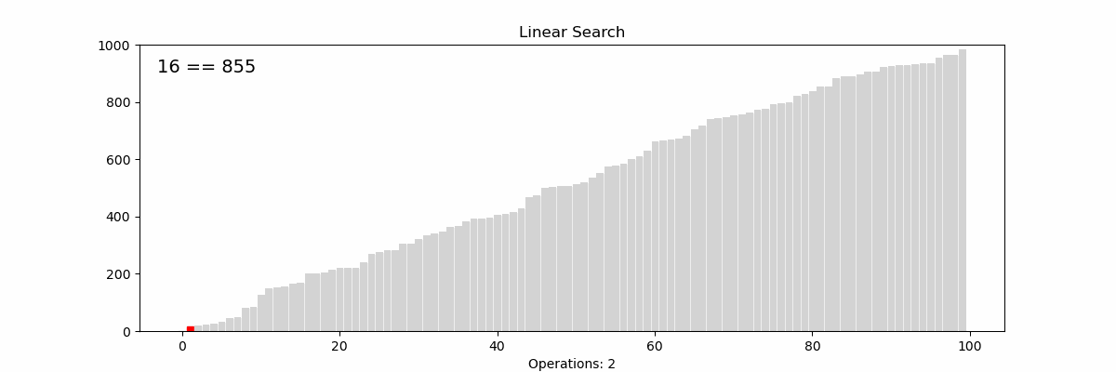

Slide 14
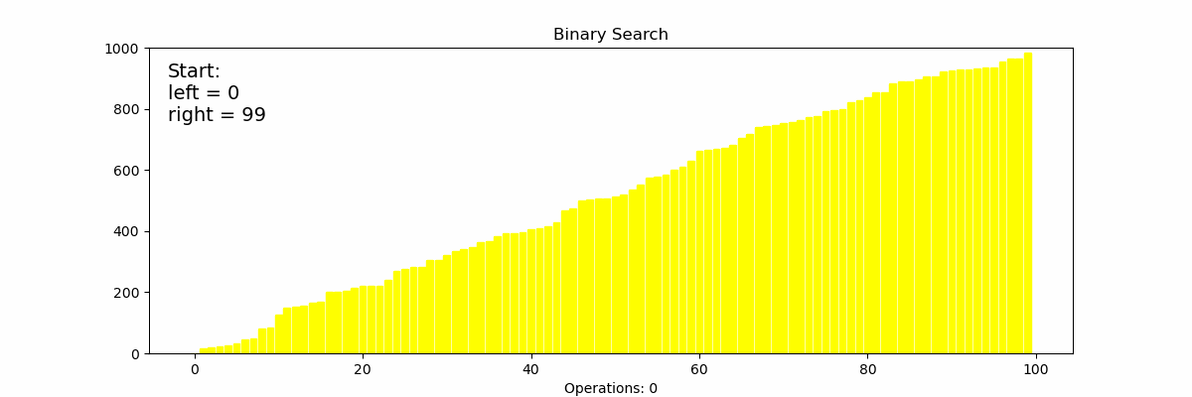

Slide 15
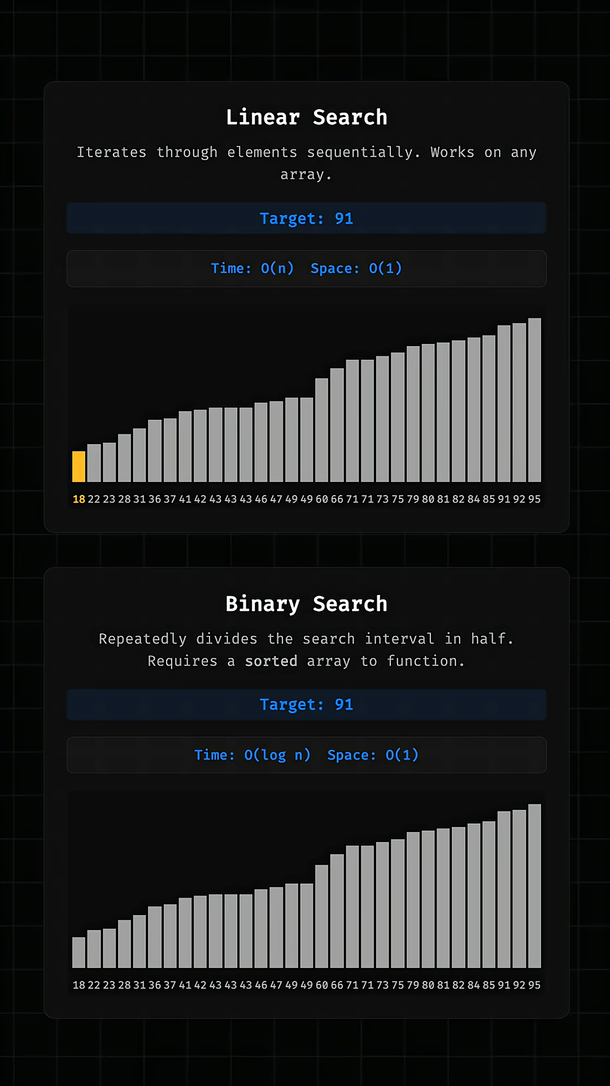
https://www.youtube.com/@onjsdev/shorts

Slide 16
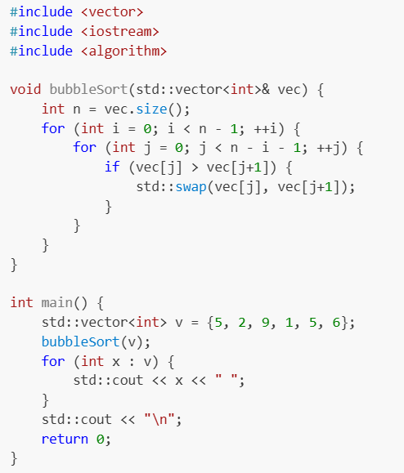
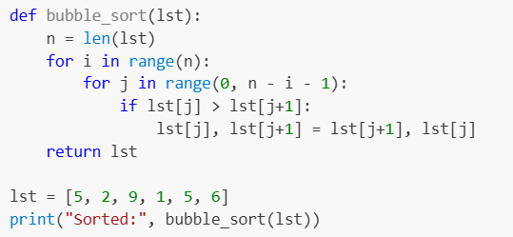
O(n²) – Bubble Sort
c++
python

Slide 17
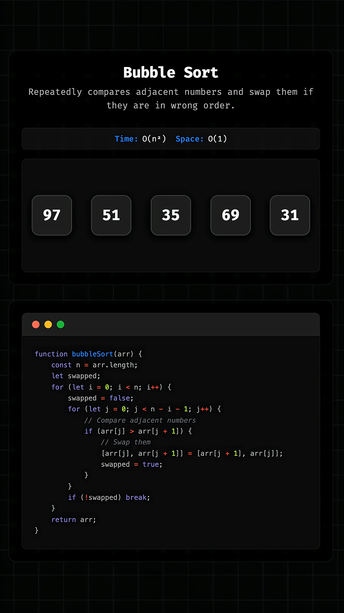
https://www.youtube.com/@onjsdev/shorts

Slide 18
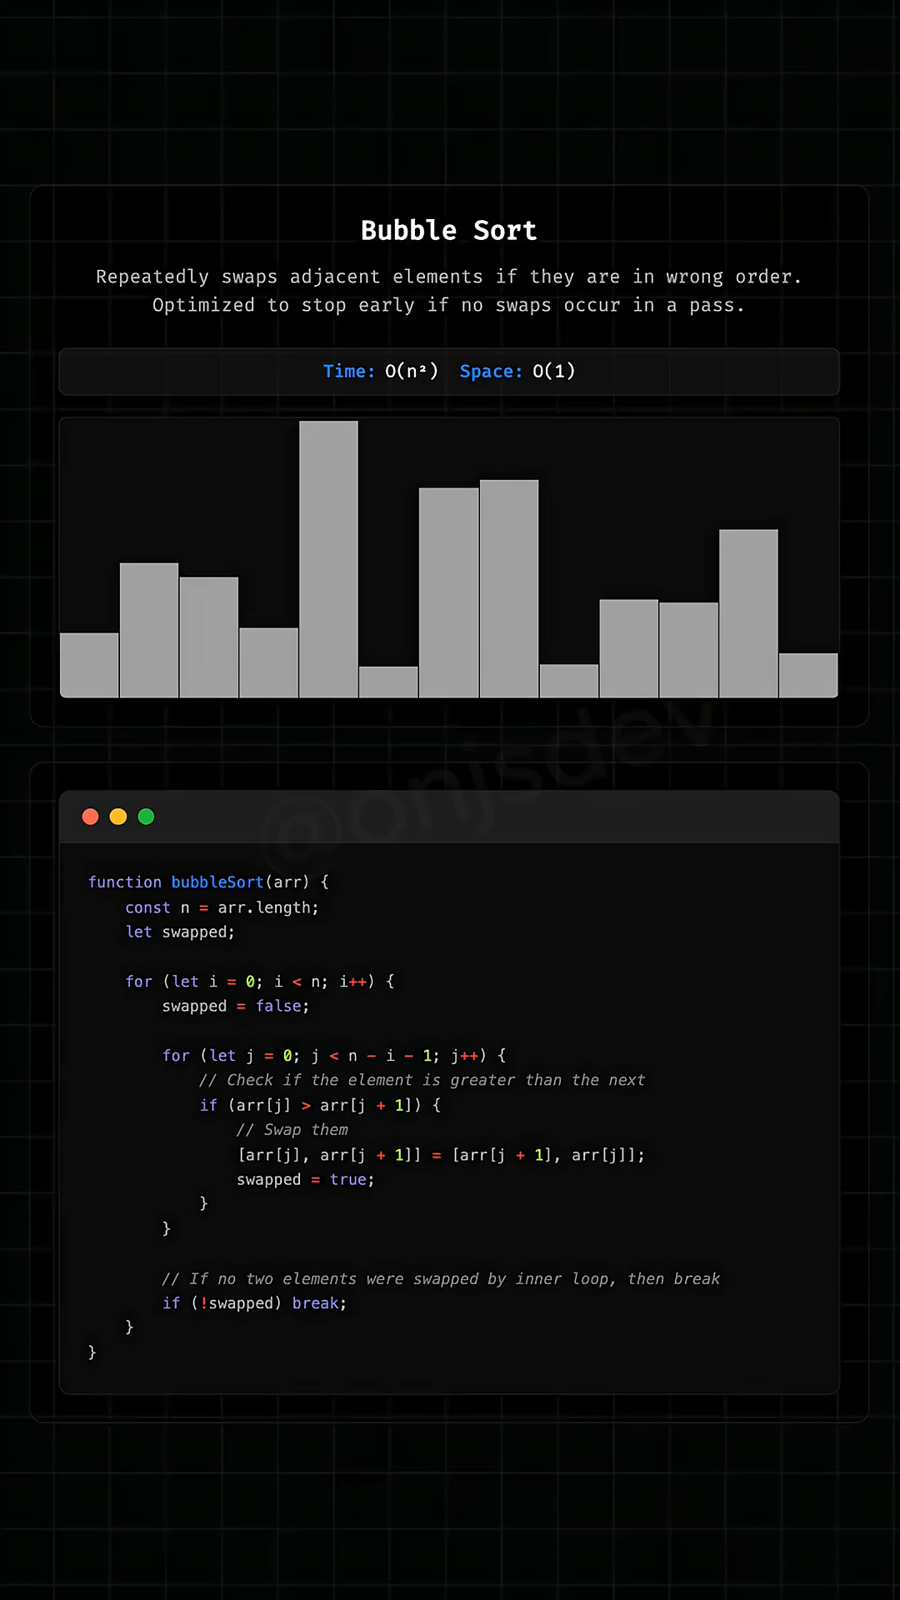
https://www.youtube.com/@onjsdev/shorts

Slide 19
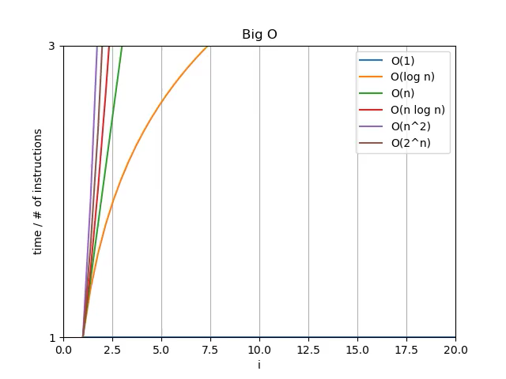
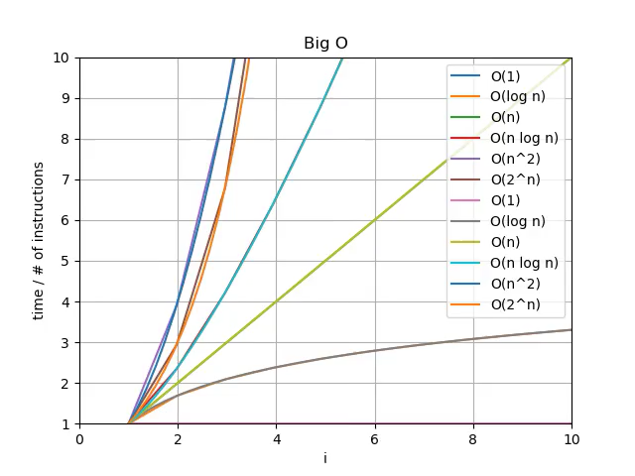

Slide 20
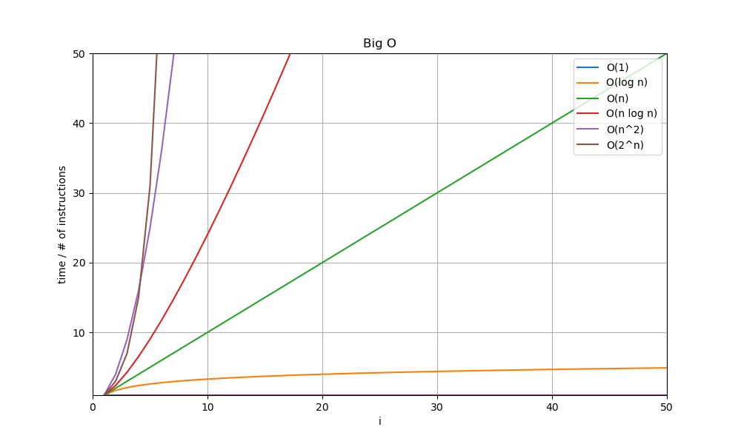
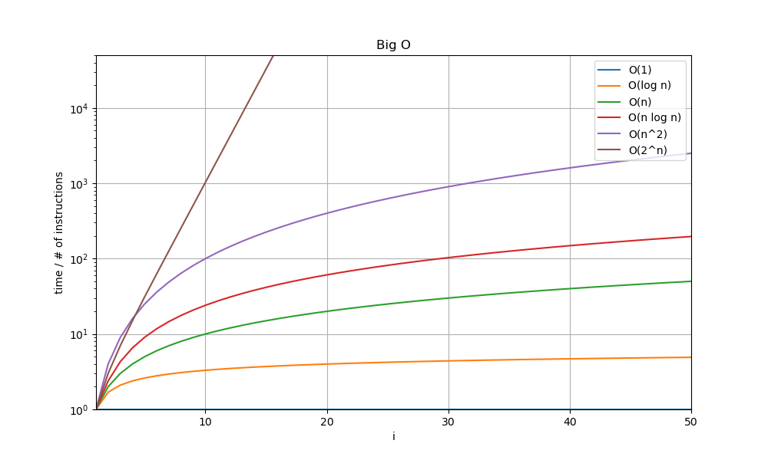
Linear/log plotting

Slide 21
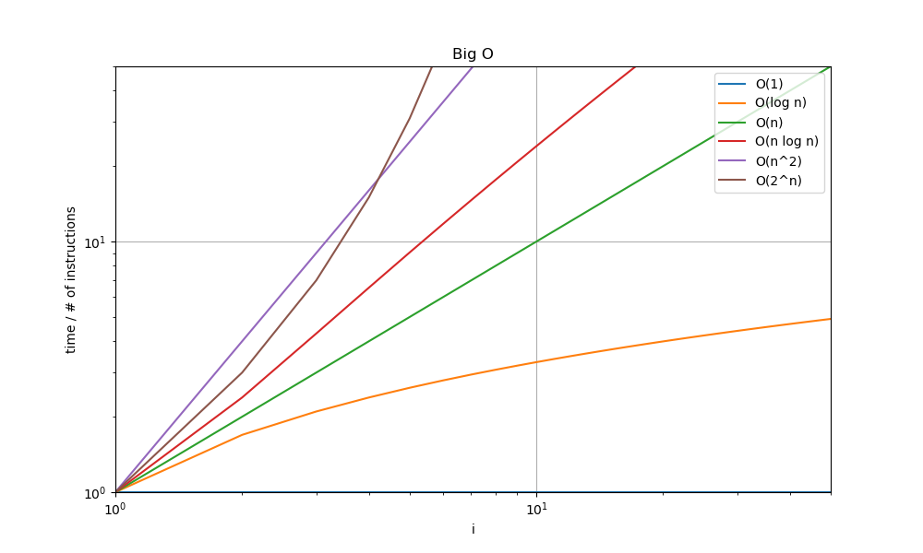
Linear/log/double log

Slide 22
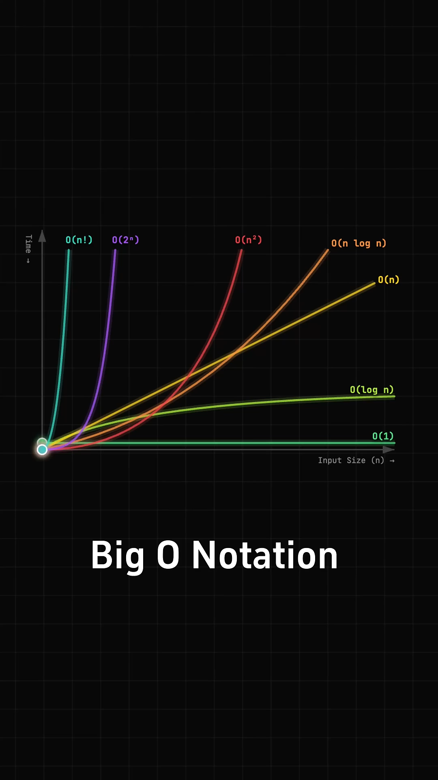
https://www.youtube.com/@onjsdev/shorts

Slide 23
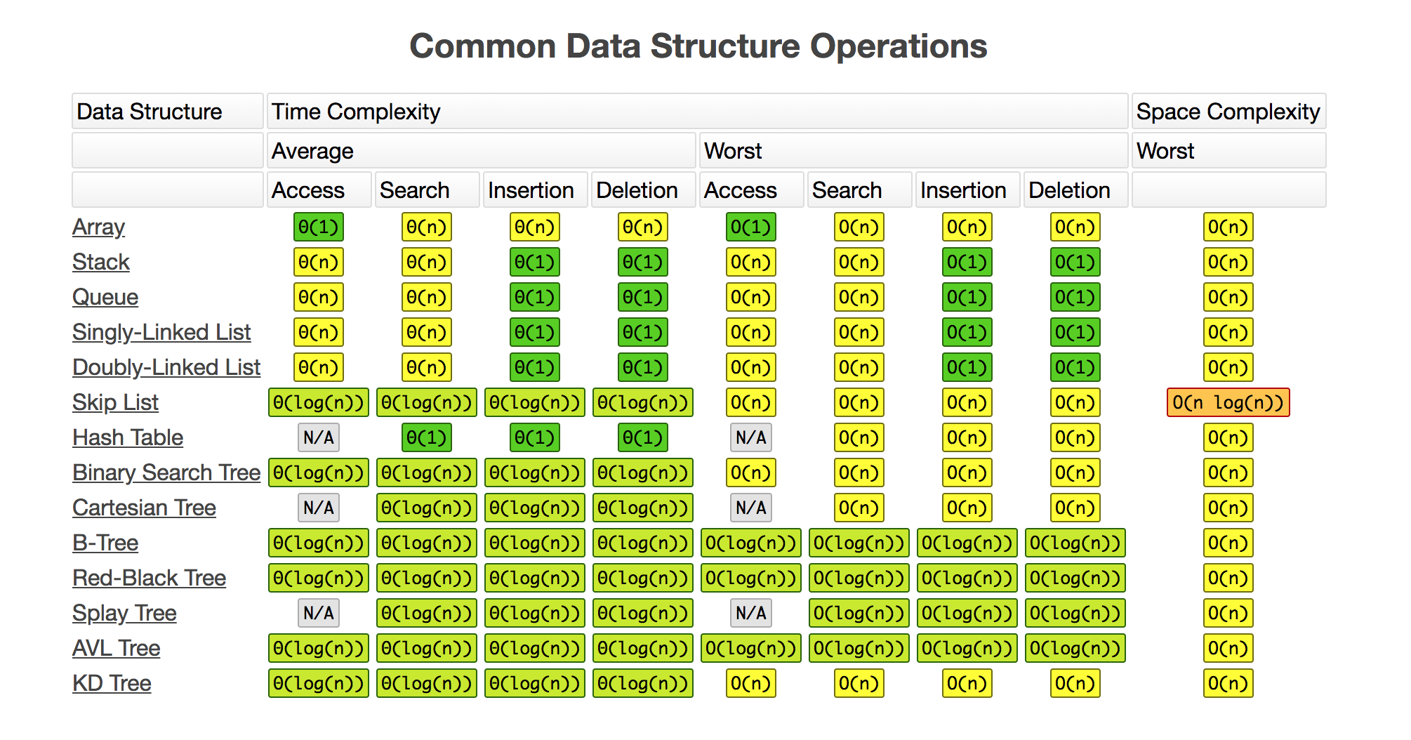
https://jojozhuang.github.io/tutorial/big-o-cheat-sheet/

Slide 24
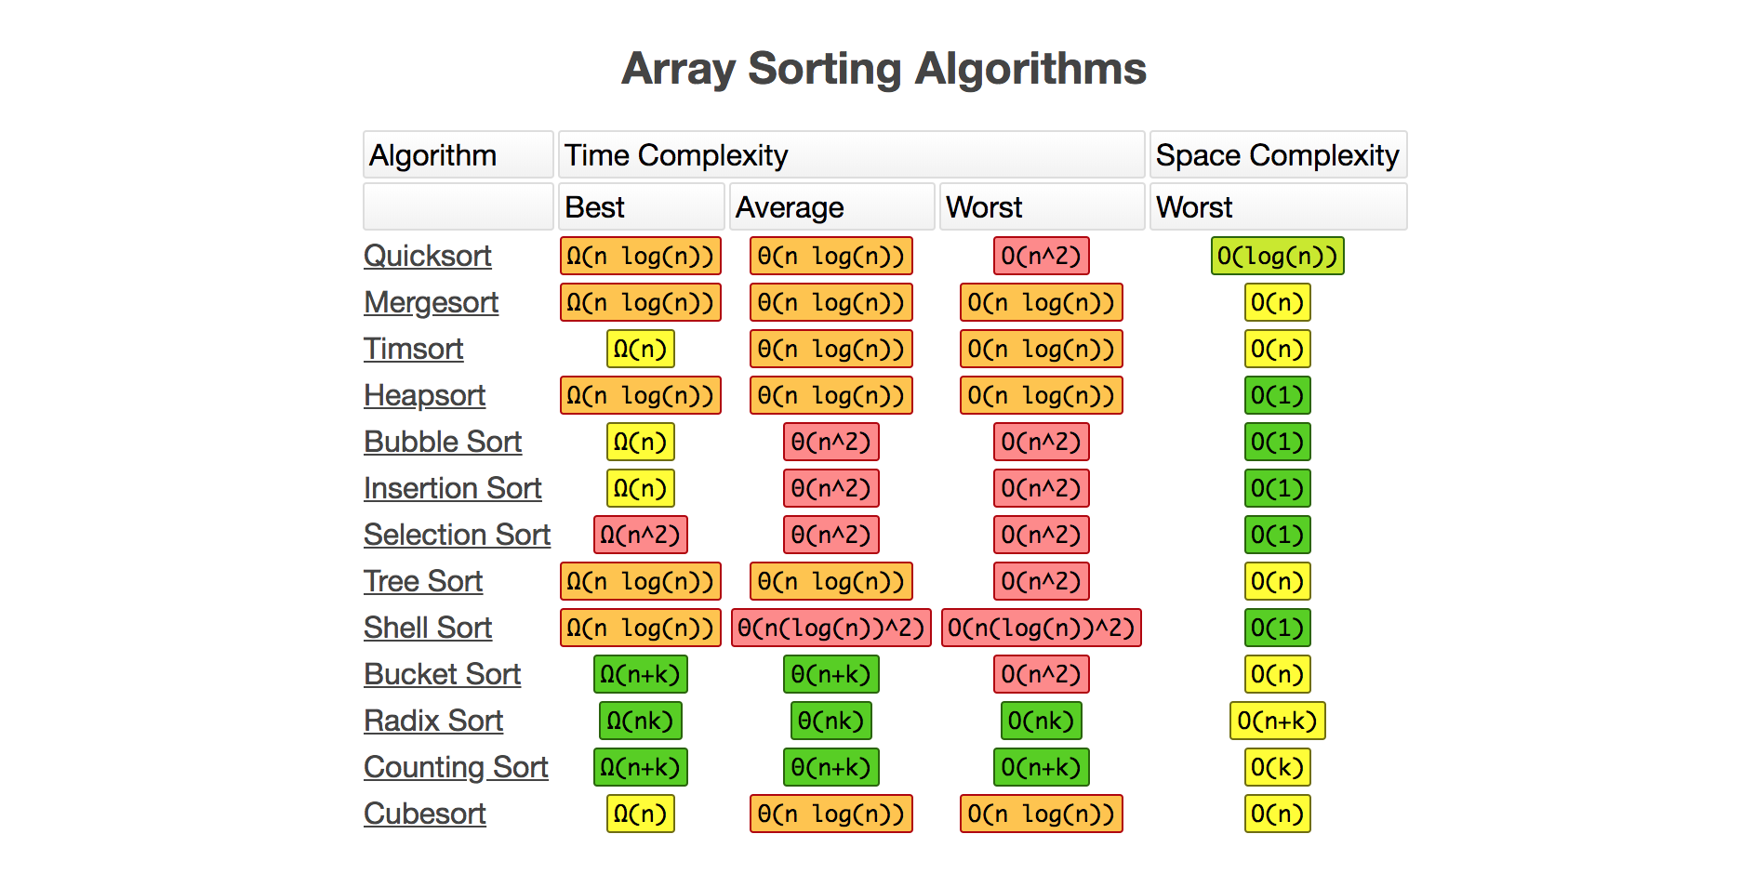
https://jojozhuang.github.io/tutorial/big-o-cheat-sheet/

Slide 25
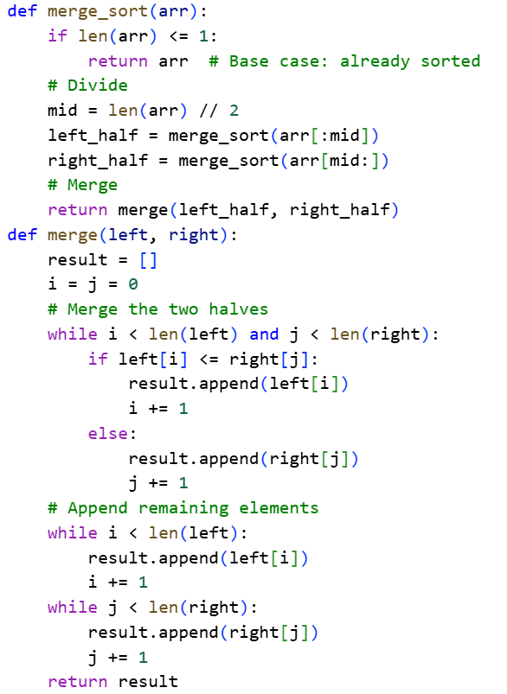
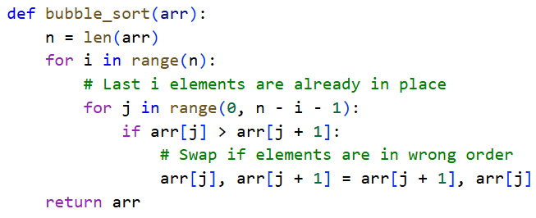
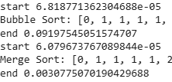
Bubble vs Merge Sort
https://colab.research.google.com/drive/1yu-4EEUHDfq8Bd_B-zxY9x91SdwzIlr2?usp=sharing

Slide 26
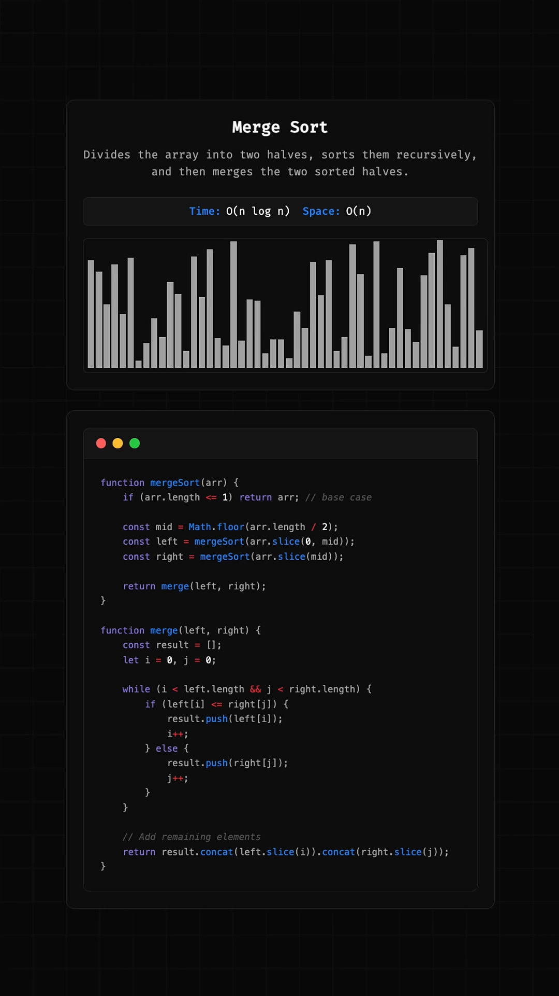
https://www.youtube.com/@onjsdev/shorts

Slide 27
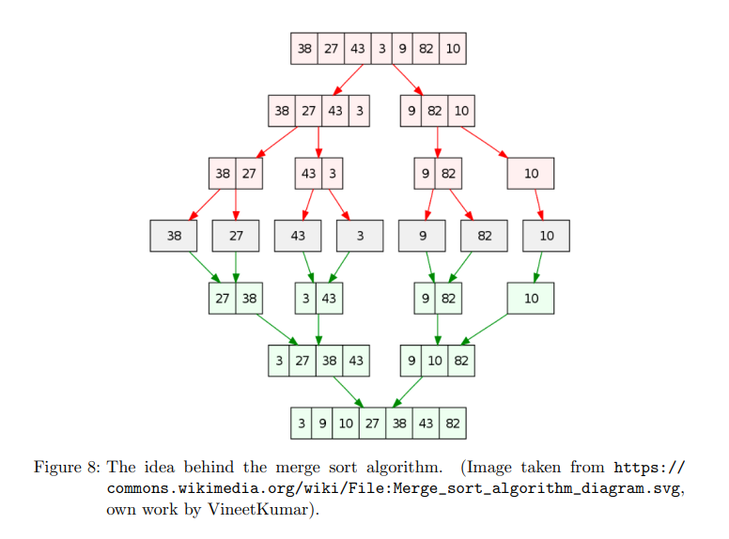

Slide 28
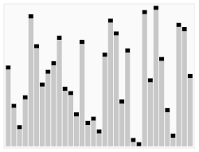
Quicksort

Slide 29
// Sorts (a portion of) an array, divides it into partitions, then sorts those
algorithm quicksort(A, lo, hi) is
// Ensure indices are in correct order
if lo >= hi || lo < 0 then
return
// Partition array and get the pivot index
p := partition(A, lo, hi)
// Sort the two partitions
quicksort(A, lo, p - 1) // Left side of pivot
quicksort(A, p + 1, hi) // Right side of pivot
// Divides array into two partitions
algorithm partition(A, lo, hi) is
pivot := A[hi] // Choose the last element as the pivot
// Temporary pivot index
i := lo
for j := lo to hi - 1 do
// If the current element is less than or equal to the pivot
if A[j] <= pivot then
// Swap the current element with the element at the temporary pivot index
swap A[i] with A[j]
// Move the temporary pivot index forward
i := i + 1
// Swap the pivot with the last element
swap A[i] with A[hi]
return i // the pivot index

Slide 30
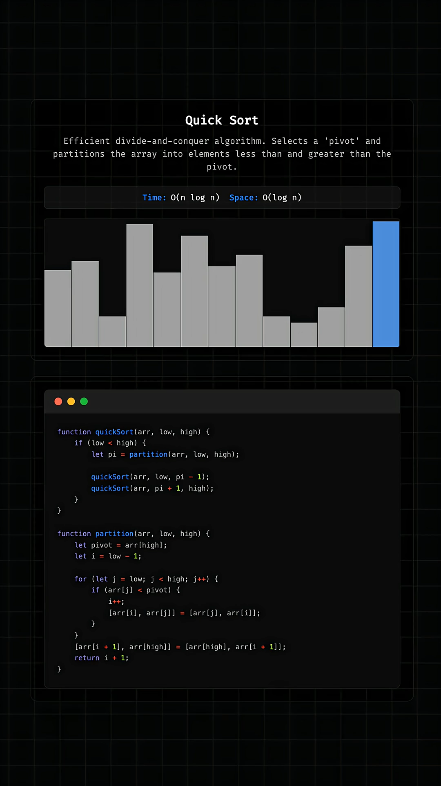
https://www.youtube.com/@onjsdev/shorts

Slide 31
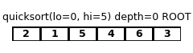
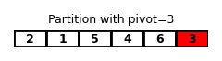
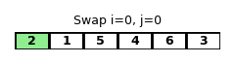
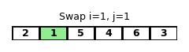
if A[j] <= pivot then
swap A[i] with A[j]
i := i + 1
5, 4 and 6 > 3 so no swap!

Slide 32
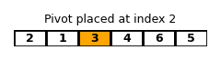
if A[j] <= pivot then
swap A[i] with A[j]
i := i + 1
swap A[i] with A[hi]

Slide 33
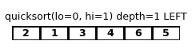
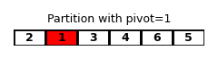
quicksort(A, lo, p - 1)
if A[j] <= pivot then
swap A[i] with A[j]
i := i + 1

Slide 34
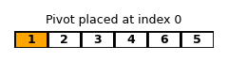
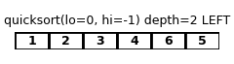
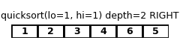
if A[j] <= pivot then
swap A[i] with A[j]
i := i + 1
swap A[i] with A[hi]
if lo >= hi || lo < 0 then
return

Slide 35
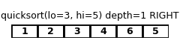

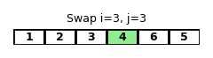
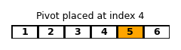
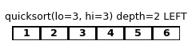
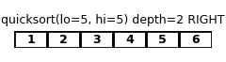
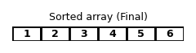
quicksort(A, p + 1, hi)
6 > 5 so no swap!
swap A[i] with A[hi]

Slide 37
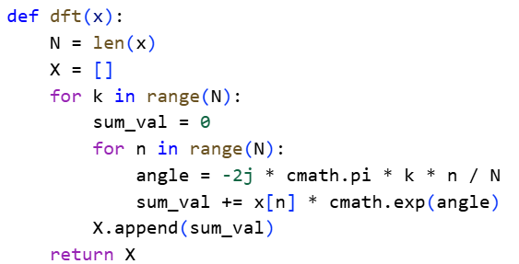


DFT vs FFT
https://colab.research.google.com/drive/1cXlXxxmsZ7oSHuJ64VId-L6vfUOwOROs?usp=sharing

Slide 38


De opdracht!

Slide 39
De opdracht!

Slide 40


Succes!!!!

